Slide 1
Introduction to
Natural Language Processing
Chris Gruber

Slide 2
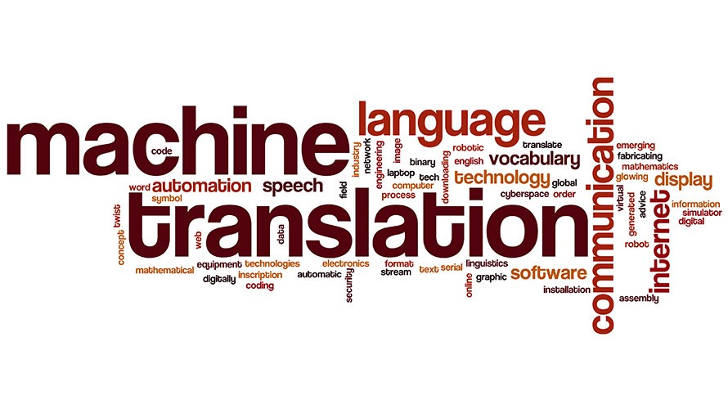
What is Natural Language Processing?
Loose collection of tools and techniques for working with text data

Slide 3
Text is Terrible
Many challenges when working with text data:
Language is infinitely complex
Languages are alive
Words can have many meanings (polysemy)
Language can be ambiguous
wtf is an acronym

Slide 4
Text is Terrible
Human factors also play a significant role:
Humor, sarcasm, and other subtleties
Neologisms, slang
Misspellings, non-standard usages, etc.
No technique will ever be 100% accurate

Slide 5
Text is Terrible
The complex houses married and single
students and their families
The horse raced past the barn fell
Buffalo buffalo Buffalo buffalo buffalo
buffalo Buffalo buffalo

Slide 6
Types of Text
Formal
Informal
The Instant Pot Ultra is the next generation in kitchen appliances. Designed for the home chef...
Next, I’ll review the Instant Pot Ultra. It’s much lighter than the previous generation and has a nifty new feature...
dont waste you money on this piece OF CRAP it worked twice heard a pop second tmie...

Slide 7
What are Some Common NLP Applications?
The classics:
Sentiment analysis
Summarization of text
Text classification (topic modeling)
Machine translation
Feature generation and data extraction

Slide 8
What are Some Common NLP Applications?
Newer stuff:
Speech recognition
Semantic search (“natural question answering”)
Fraud detection
Generative models

Slide 9
Why is NLP hard?
NLP techniques tend to be blunt instruments
Many problems have solutions outside traditional ML (e.g. non-numerical output)
Variable space is enormous (~500k unique words in English)
“Context” is often built up over a long range (sentence- or paragraph-level)

Slide 10
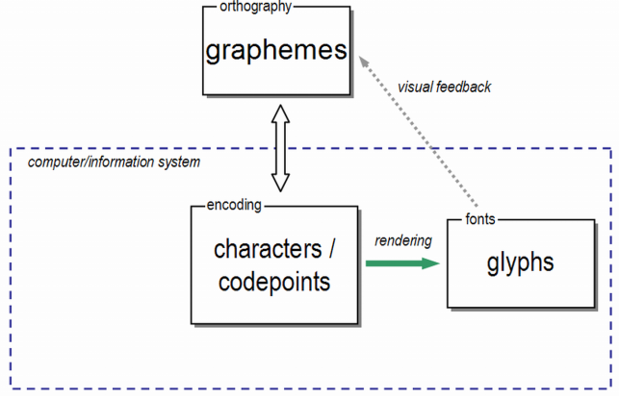
How does a computer see text?
Every text character is represented by a unique number called a codepoint
The standard encoding today is UTF-8, which consists of 1,112,064 codepoints
A given codepoint always represents the same letter, regardless of hardware

Slide 11
How can we encode a sentence?
Simplest approach: Bag of Words
Construct a vocabulary from a corpus of documents
Vocabulary: {at, pizza, cat, eat, the, throw}
Eat pizza
Throw pizza at the cat [1,1,1,0,1,1]
[0,1,0,1,0,0]

Slide 12
How can we encode a sentence?
Many variations on the basic technique:
Continuous Bag of Words
N-Grams
Skip-Grams
Autoencoders
Article reviewing sentence encoding techniques

Slide 13
How do you process data for NLP work?
Many standard approaches to prepare data for NLP applications:
Removal of “stop words”
Lowercasing and normalization
Word stemming and lemmatization
Augmentation, for example with a POS tagger

Slide 14
How do you process data for NLP work?
Always recommended: lowercasing and noise removal
Usually recommended: basic normalization
Project-dependent: stop word removal, stemming, lemmatization, augmentation
Great article outlining text preprocessing for NLP

Slide 15
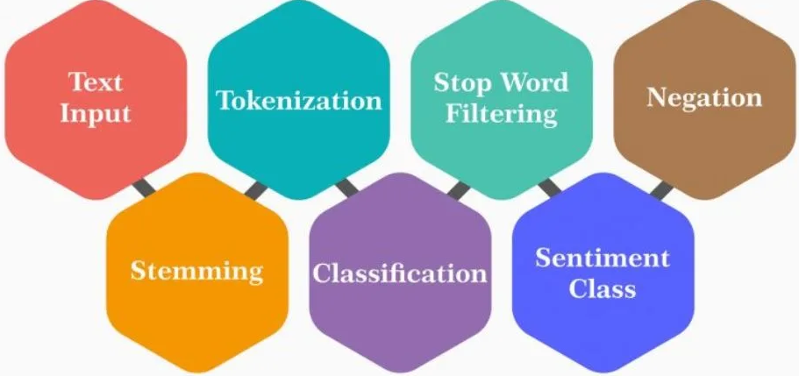
How do you work with text data in Python?
Many popular frameworks and packages
NLTK is the best-known and has implementations of common techniques

Slide 16
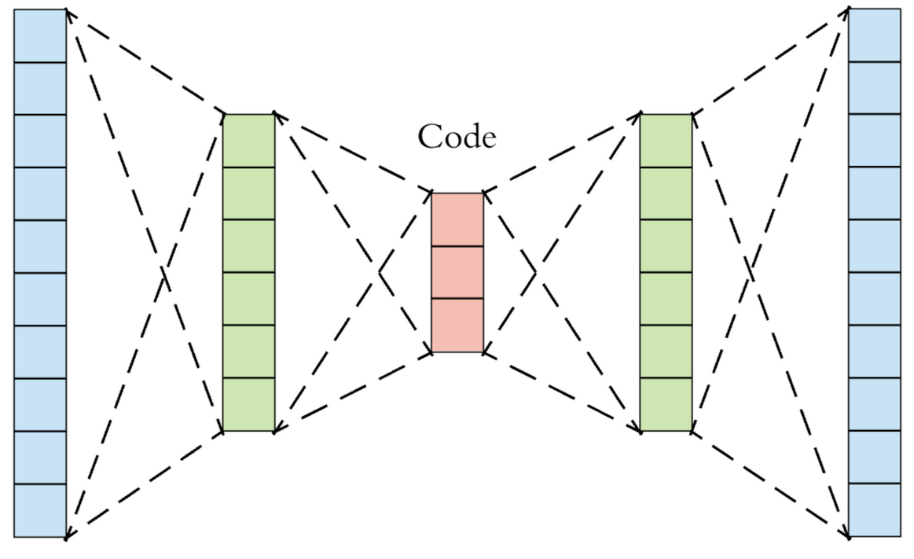
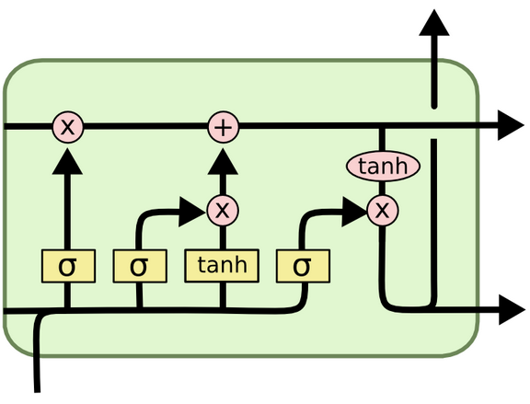
How does deep learning intersect with NLP?
Neural autoencoders:
Language generation
Text embeddings
Recursive and convolutional networks:
Language translation
Semantic search

Slide 17
How do I learn more about NLP?
Awesome multi-language guide to learning NLP
Recommended beginner’s guide
Video-focused introduction to NLP
NLP newsletter

Slide 18
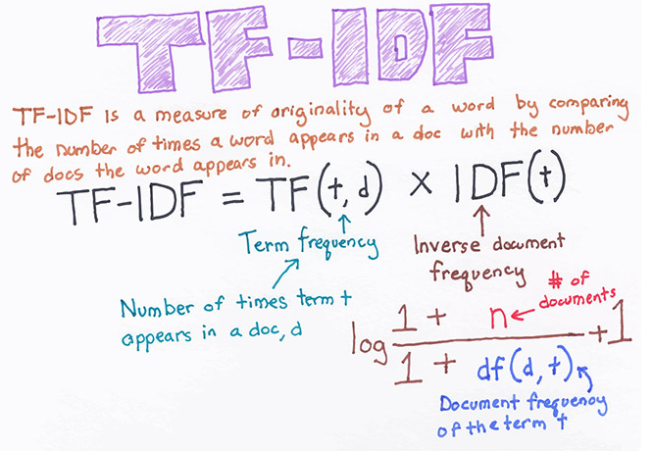
DEMO
Topic Modeling with TF-IDF

Slide 19
Thanks!
https://github.com/ChristopherGruber/Introduction_to_NLP
Notes:
Plug the ChiPy mentorship!

